Slide 1
Disclosing Software Vulnerabilities
Notes:
Flo

Slide 2
Discovered a Vulnerability – What to do?
Do nothing.
Exploit or sell.
Make sure you found it legally.
Tell the vendor.
Tell everyone.
Disclose responsibly
Notes:
Flo

Slide 3
Why you should do something.
Notes:
Flo:
If you found it, it is likely someone else will find it too (or already has).
If you do nothing, nothing will happen.

Slide 4
Why you might consider selling.
Notes:
Frank:
Black market/Gray Market explanation
Sometimes vendors will pay (bug bounties)
Don't exploit.

Slide 5
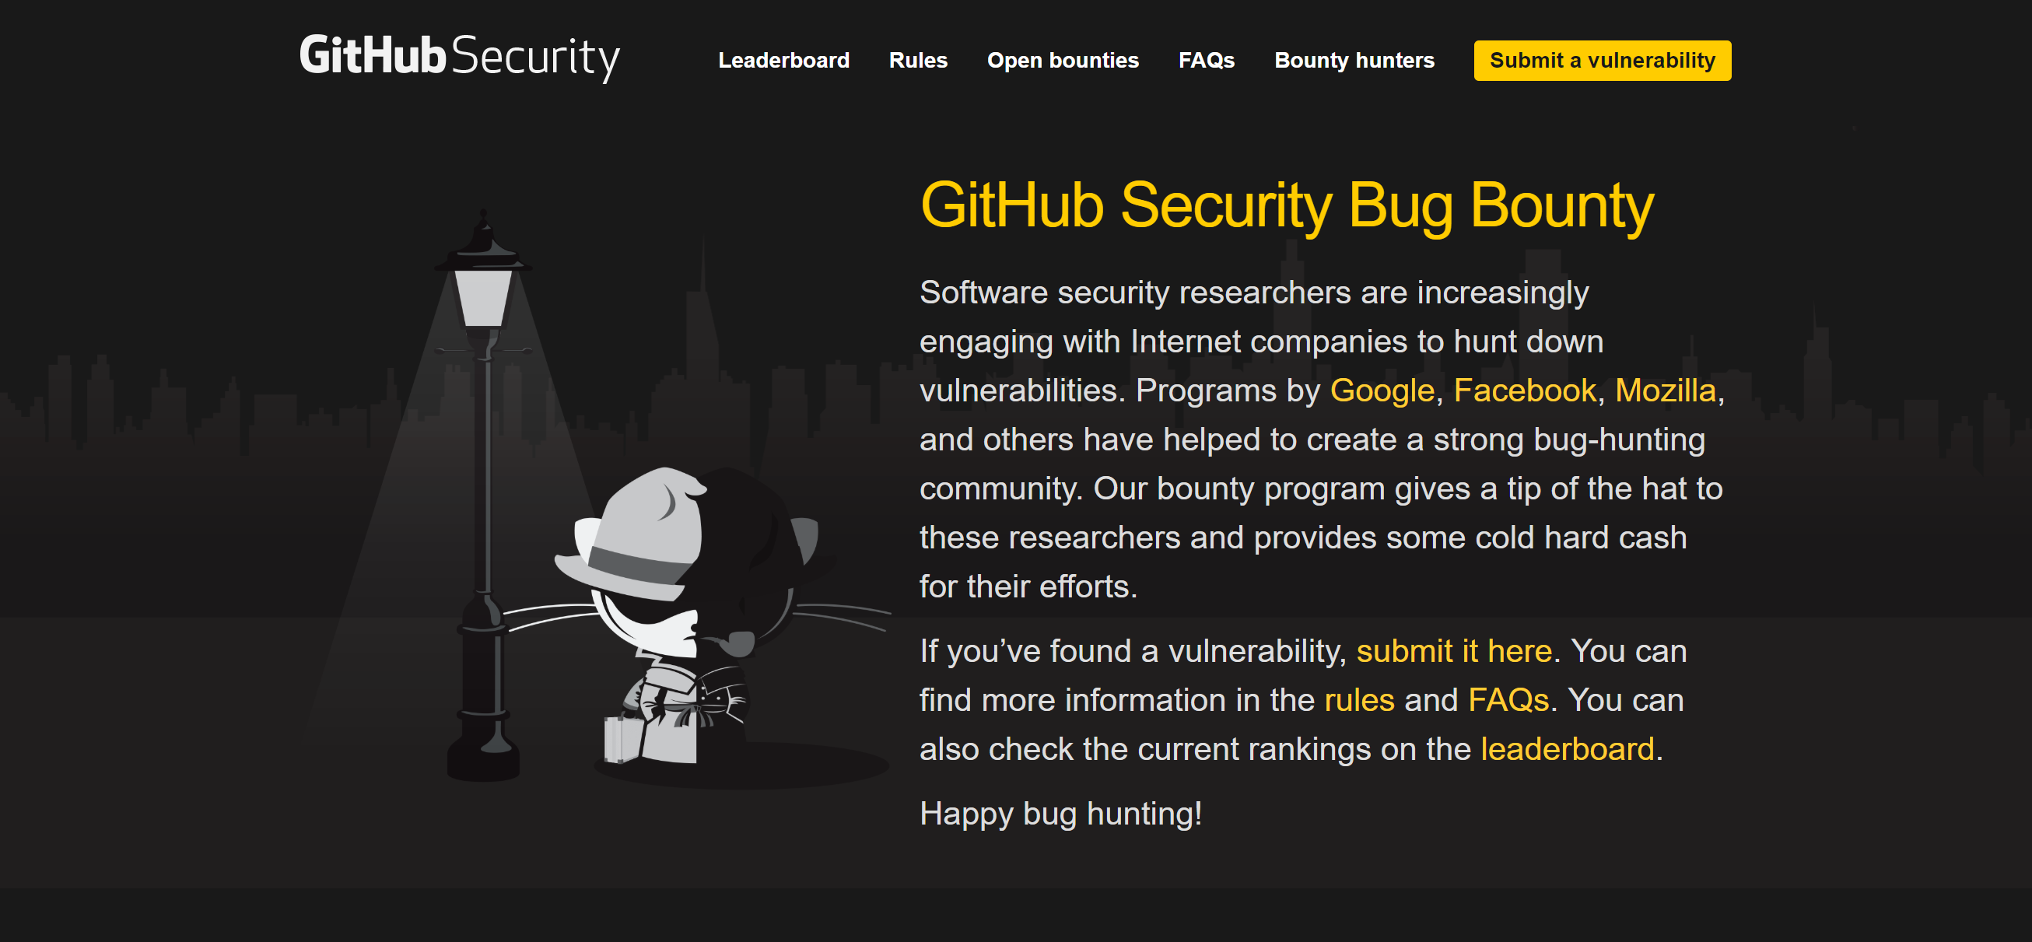
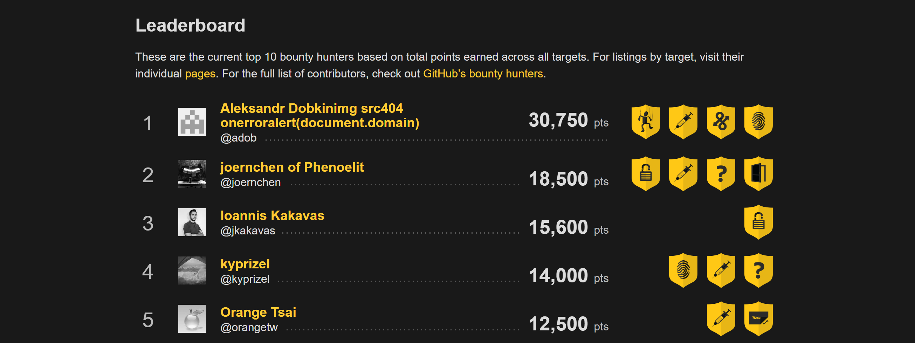

Notes:
Frank

Slide 6

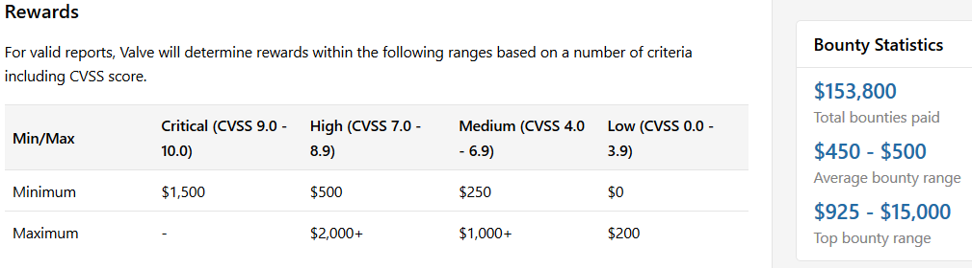
Notes:
Frank

Slide 7
Why you should not sell to third-parties.
Notes:
Frank:
Often said to be bought by governments to develop cyber weapons
Will likely not be fixed by the vendor

Slide 8
Make sure you won't get sued.
Notes:
Frank
Make sure you did not compromise user data
When pen-testing, use fake-data / VMs
Don't attack live systems
If you did accidently, search for legal advice.

Slide 9
Why only telling the vendor is suboptimal.
Notes:
Flo:
Often no incentive to fix (market domination, competitors have vulnerabilities too)
Vendor can take a really long time to fix
Vendor might try to sue you

Slide 10
Why telling everyone is suboptimal, too.
Notes:
Flo:
Everyone includes potential attackers
Vendor has no time to fix
Live systems may be put at risk
Lives may be put at risk (if the system is critical)

Slide 11
How everyone can profit.
Notes:
Frank:
Tell vendor of vulnerability with reasonable time constraints to patch.(Vulnerability report maybe on later page?)
After deadline has passed, vulnerability can be made public
Consider including an experienced third-party like CERT/CC

Slide 12
How to disclose vulnerabilities with CERT/CC.
provides information and/or patch to
Finder
Vendor
Deployer
reports to
shares information with
provides information to
Reporter
reports to
Coordinator
provides information to
Notes:
Frank

Slide 13
So what to do now?
Do nothing. - No!
Exploit or sell. - Don't exploit, only sell to the vendor.
Make sure you found it legally. - Don't risk getting sued.
Tell the vendor. - Only if it is critical.
Tell everyone. - Only when the vendor is unresponsive.
Disclose responsibly - Do that!
Notes:
Frank

Slide 14
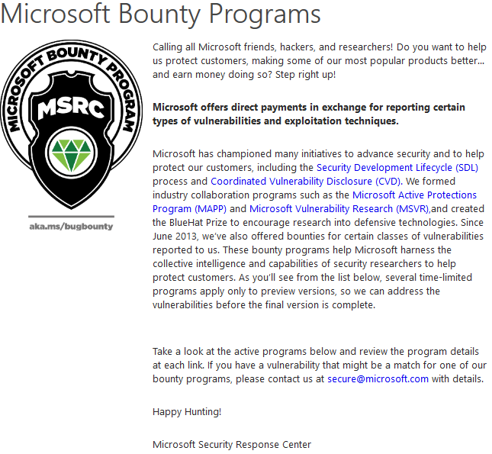
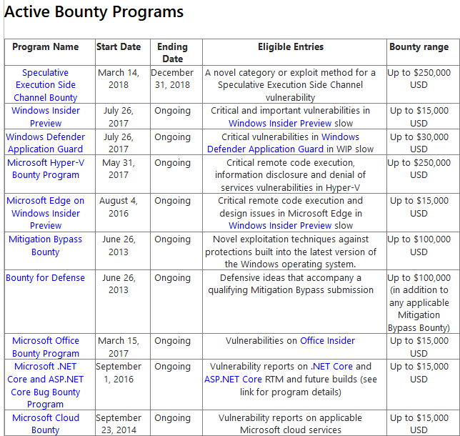

Slide 15

So what to do now?

Do nothing.
Exploit or sell.
Make sure you found it legally.
Tell the vendor.
Tell everyone.
Disclose responsibly.
No!
Don't exploit, only sell to the vendor.
Don't risk getting sued.
Only if it is critical.
Only when the vendor is unresponsive.
Do that!


☞




